Slide 1
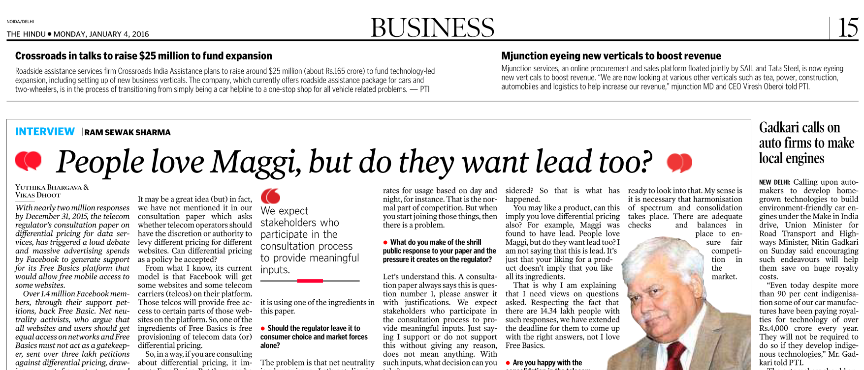


Slide 2
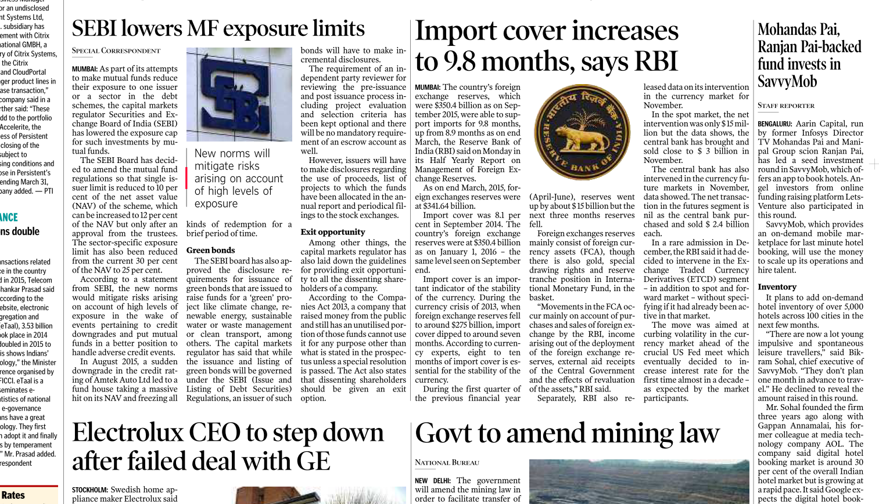
Not everything in economy is important
When they do…then notedown
Notes:
Aamaa khaamai, temaa khaami walli nai karvi.

Slide 3
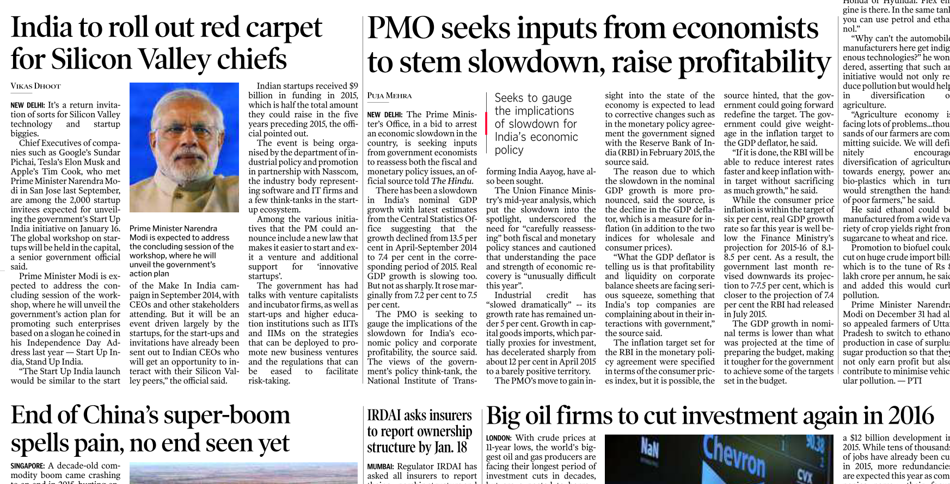

When he exactly launches that new policy….
Let the Economic survey speak on GDP and slowdown
Sufficient to know Insurance amendment.
Basics already covered.

Slide 4
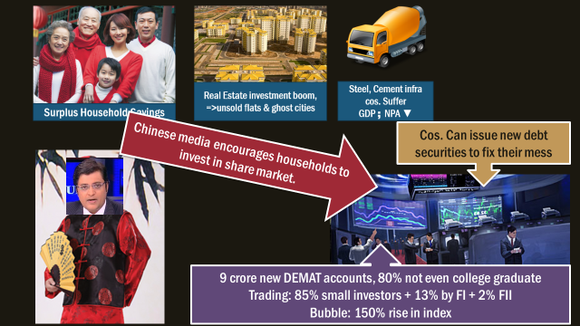
ML5/P3: China Stock crash

Slide 5
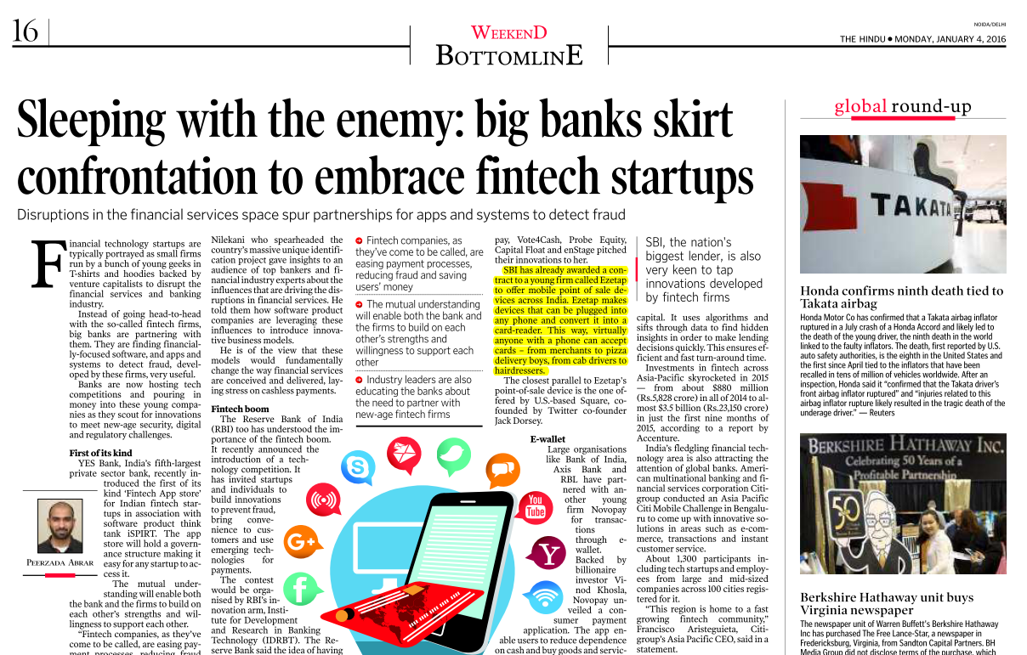



BizGK not important
Notes:
Mains- direct unlikely but indirectly a fodder on questions related to startups.

Slide 6
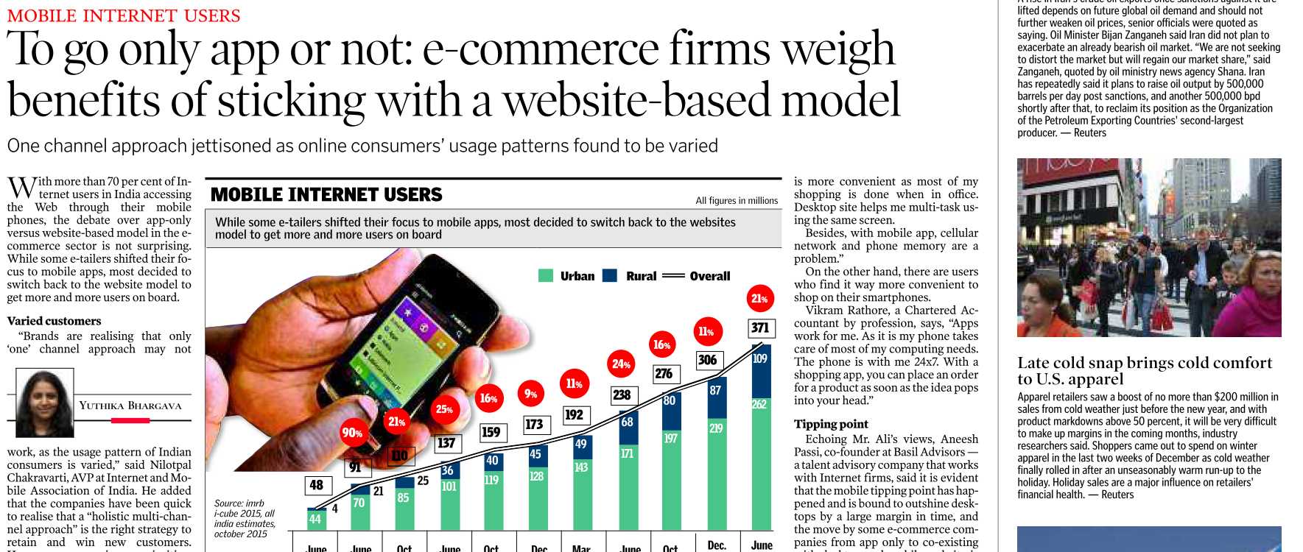
BizGK not important
Mobile => ecommerce => rural delivery, urban amnesties available. New jobs in logistics = rurbanization. Non-agro jobs.
GPS, interapp = tailormade selling. (e.g. scarfs in windy atmosphere)
Notes:
Fodder: m

Slide 7
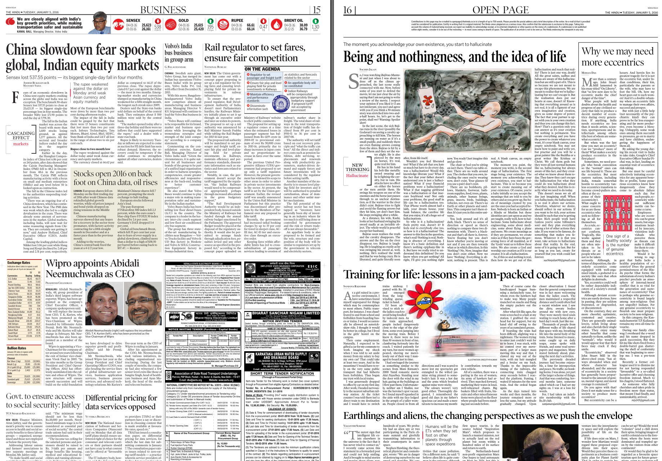


(Tuesday) Open Page:
Good for improving English
Ethics content- mostly civic duties, Empathy towards poor, elderly; attitude towards life-career.
Once you get basic idea
Notes:
Anchoring of Jagrutiben.

Slide 8
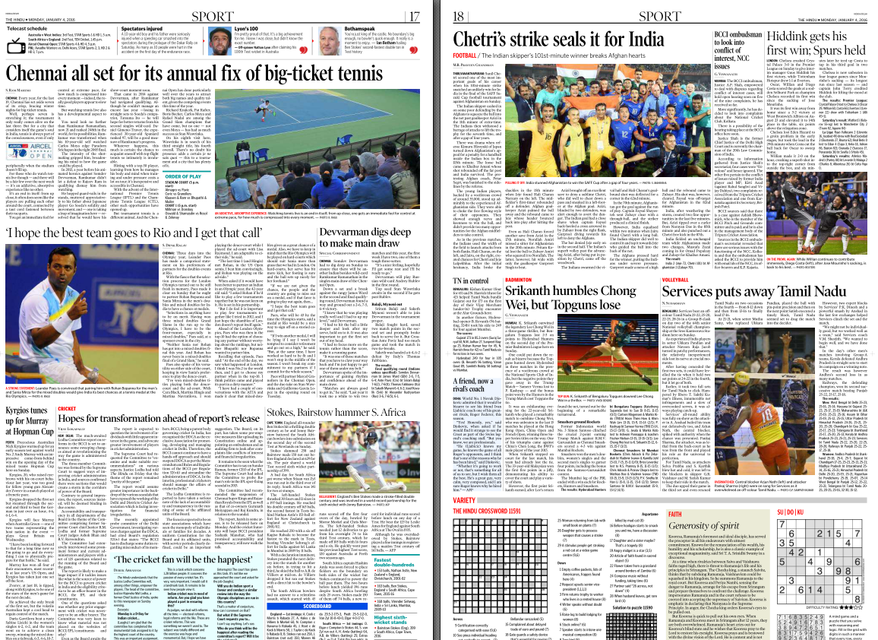
Can be done from competitive magazines
Unless something relevant to syllabus e.g. Lodha Committee on cricket administration. (GS2: regulatory bodies)

Slide 9
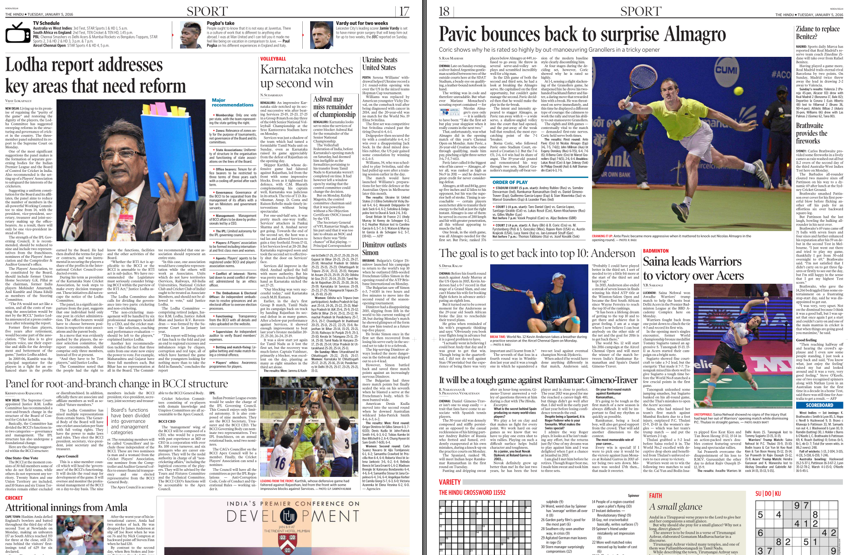
Notes:
Lodha will be on first page, editorial, and even sports page.

Slide 10
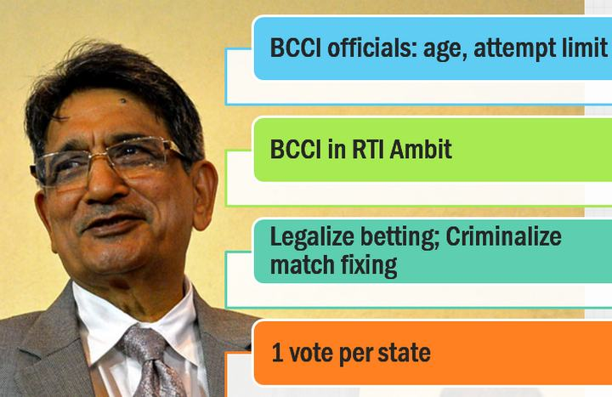
Lodha Committee
Prelim: Match the following- Committee vs. purpose (Mugdal, Lodha, Benegal, Subramanium….); who made the Committee
GS2: statutory body for sports?
GS2/GS4: transparency in sports and non-profit?
Interview: Cricket as a hobby.

Slide 11
Lodha Committee
Org. | imposes age limit, term limit, restriction on ministers and bureaucrats from entering. BCCI daily-management by professional CEO and managers with corporate work-experience. BCCI-Apex Council to have 9 members viz. BCCI president, vice-president, secretary, joint secretary and treasurer and 4 councilors. Provisions to give representation to woman and CAG- to ensure financial transparency IPL governing council with 9 members, limited autonomy, including BCCI secretary etc.
Betting and match fixing | criminalize match-and spot-fixing legalize betting by licensed betting houses. Players-officials can't do it.
State associations | Only one vote per state. One association per state. Uniformity in structure-functioning of state cricket associations. non-territorial units like Services, Railways, Universities etc. be given non-voting associate membership Make The Players’ Association
Transparency | parliament should update law to bring BCCI within RTI-ambit Players, officials have to give asset reports to BCCI

Slide 12
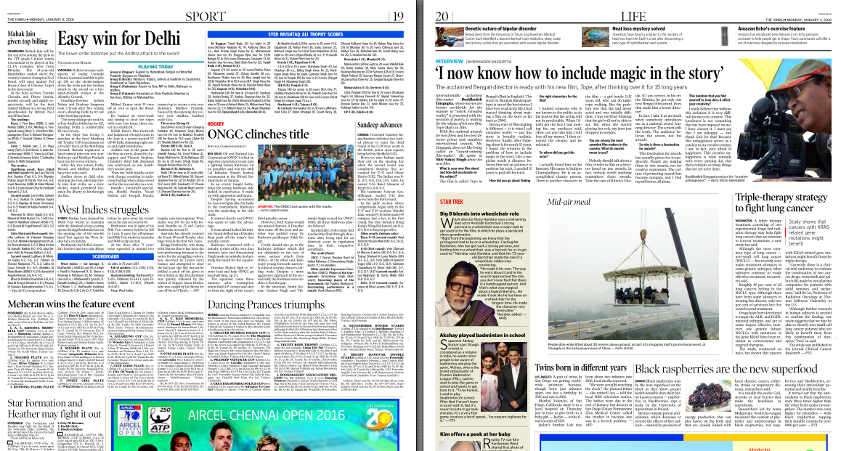
Celebrities Music, movies, art, literature
Sci-tech

Slide 13
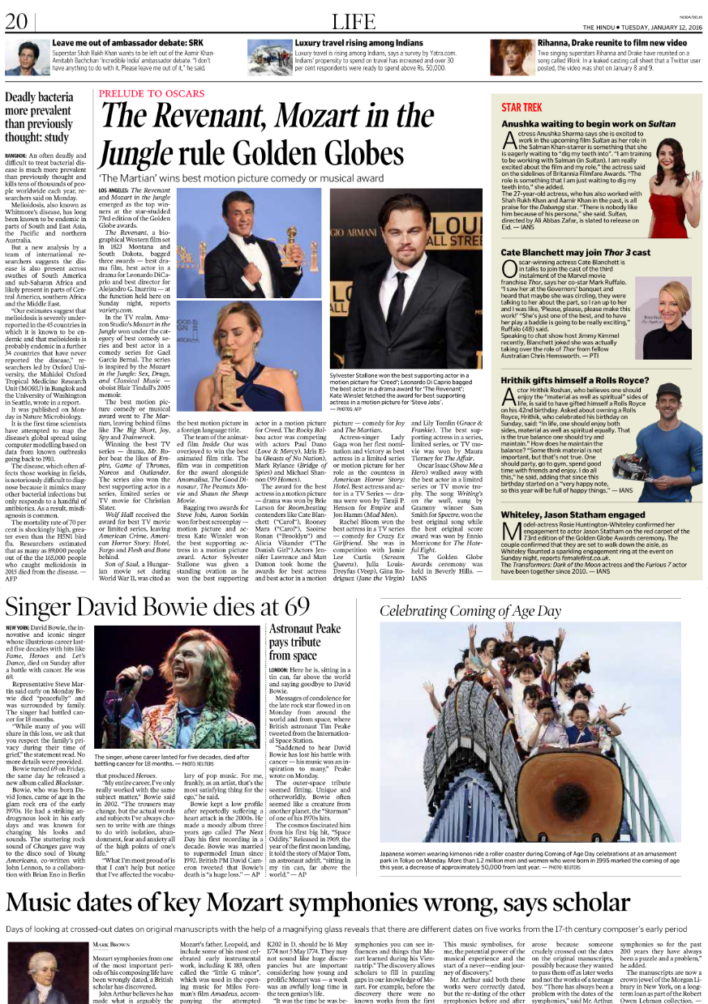
Last page: Life / Ad
Hrithik Roshan gifts himself Rolls Royce on b’day.
One should enjoy both material as well as spiritual side.
One should party, go to gym, spend good time with friends and enjoy
GS4: What is the meaning of happiness to you?

Slide 14
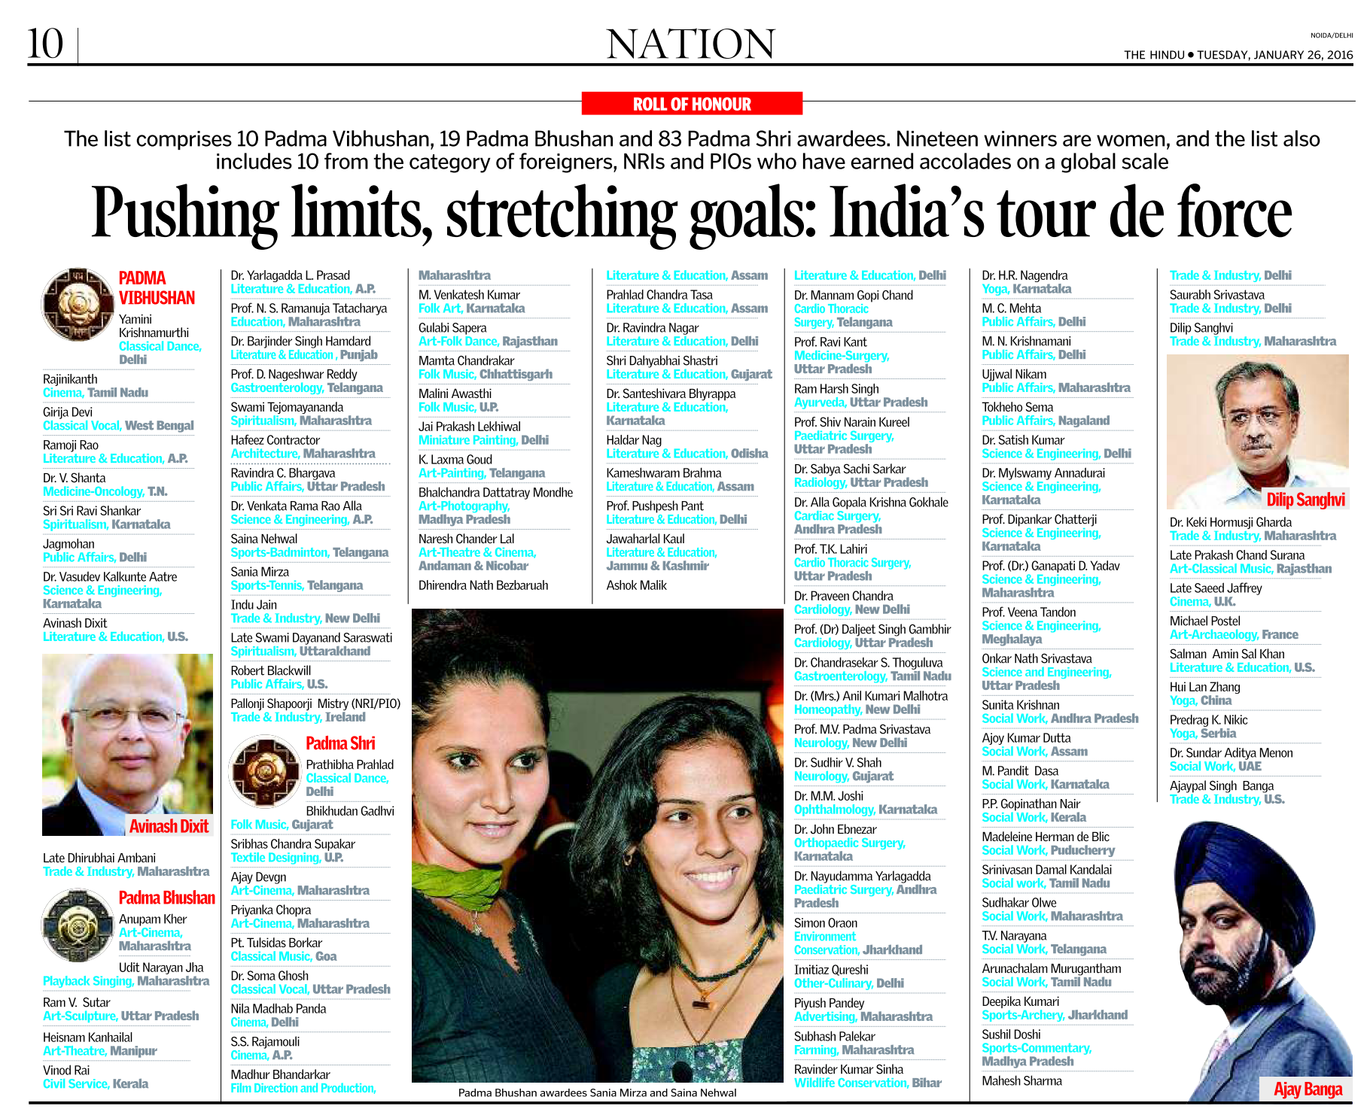
Only high profile awardees

Slide 15


Slide 16
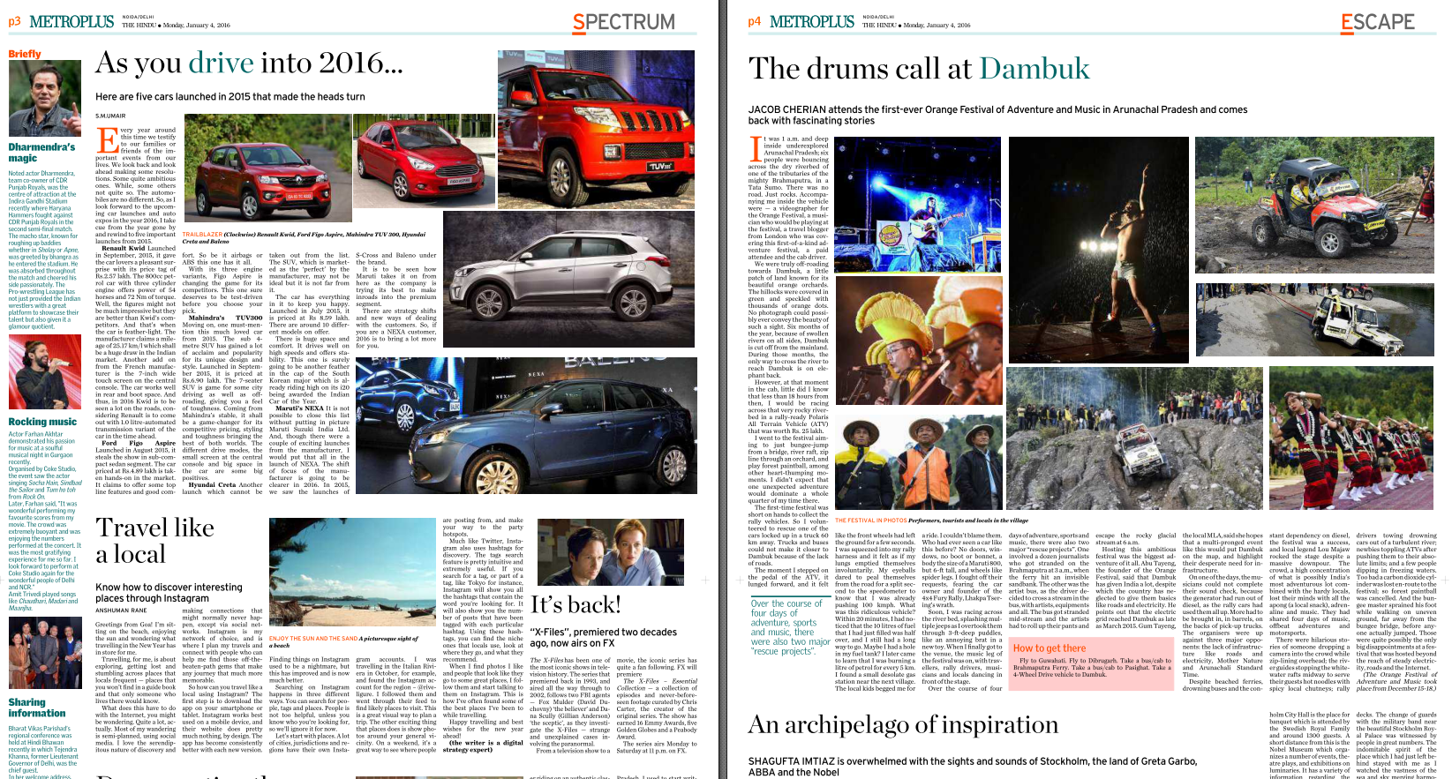

Slide 17
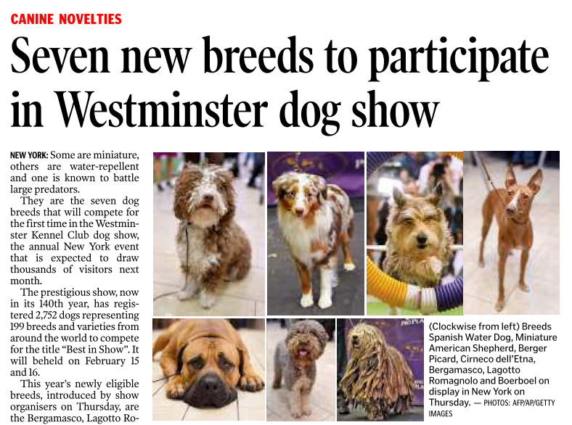
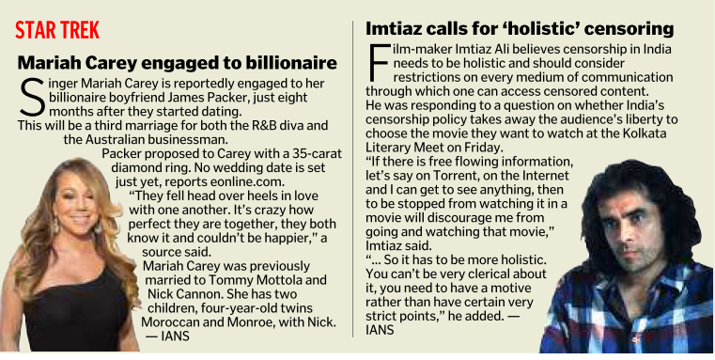

Slide 18
PIN

Slide 19
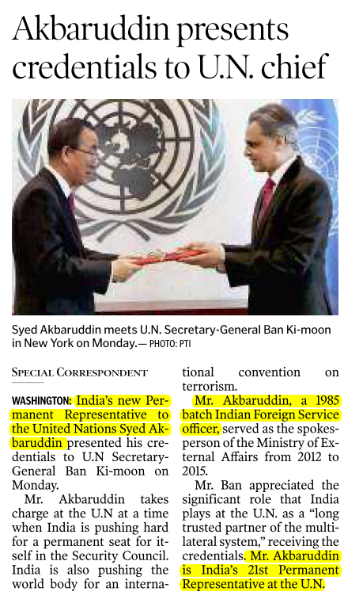
PIN: Appointments

Slide 20
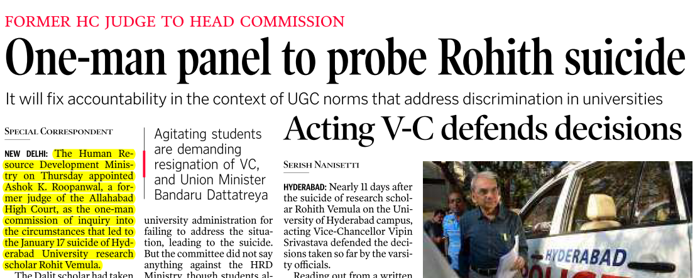
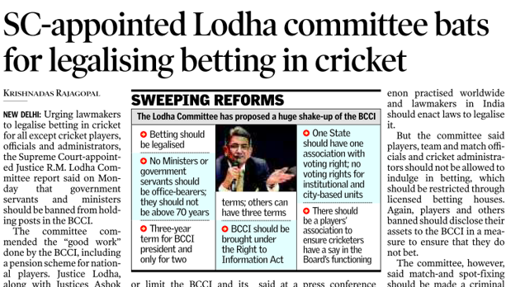

PIN: Committees

Slide 21
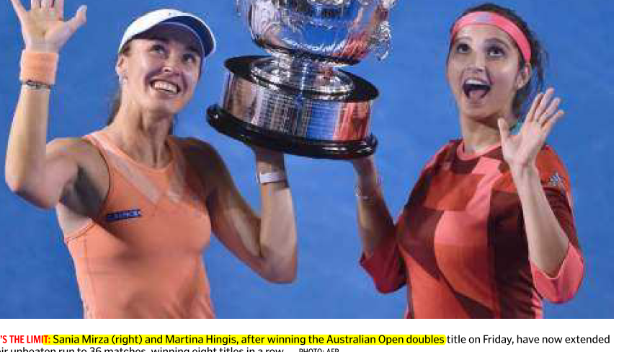
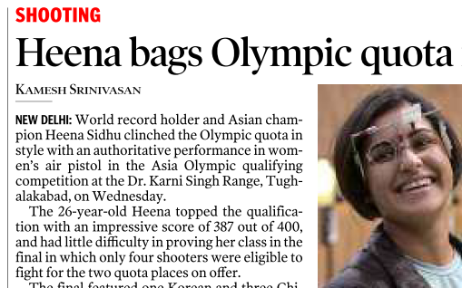
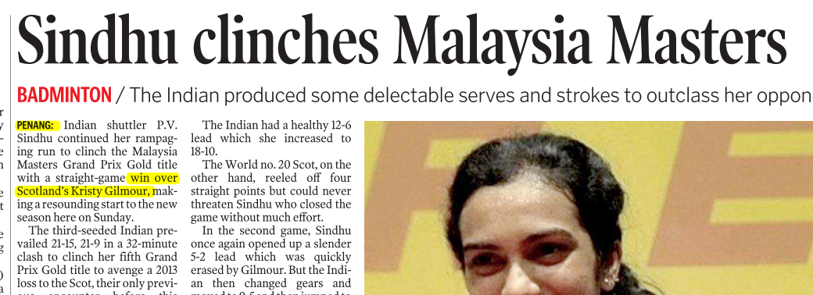
Venue
Mascot
Theme/motto
Who defeated whom
Notes:
Location and whom she defeated?

Slide 22
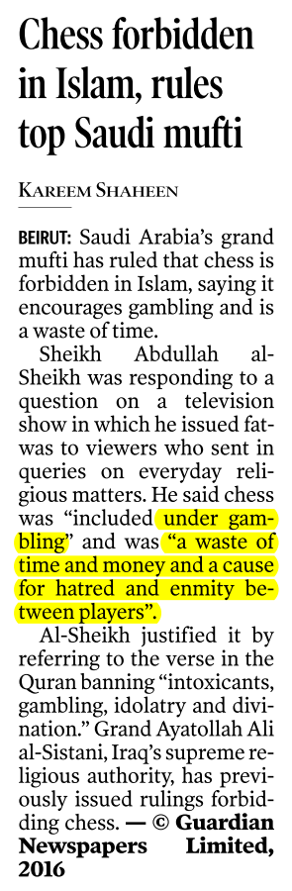
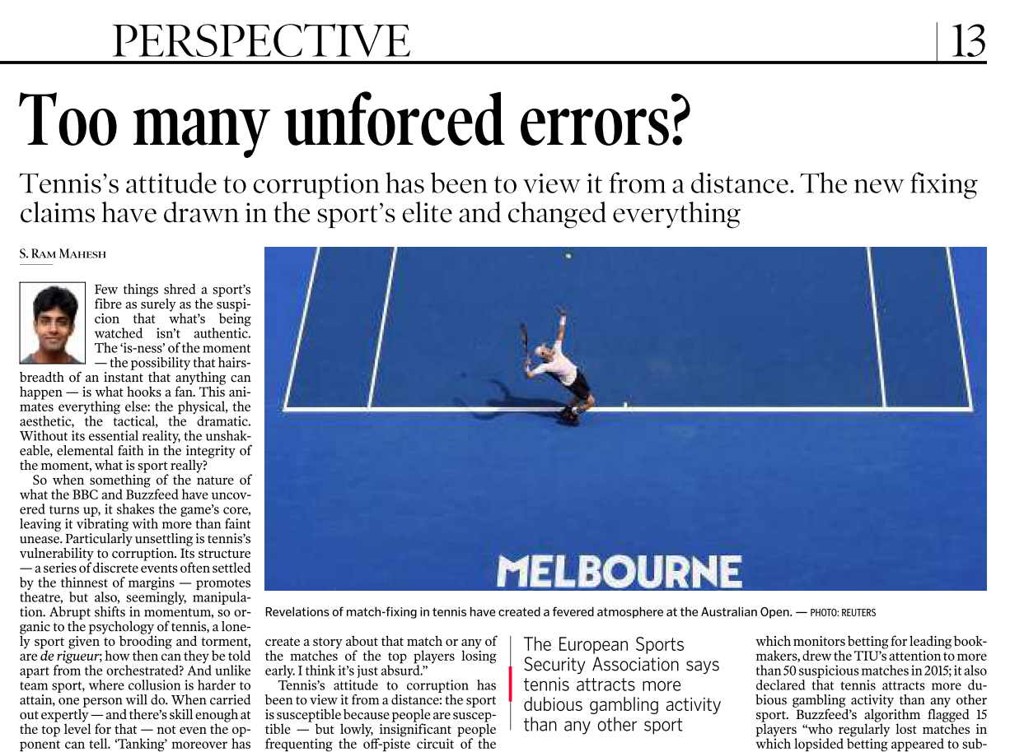
If the said sports is your hobby…

Slide 23
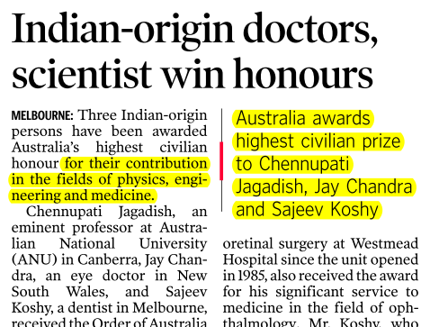


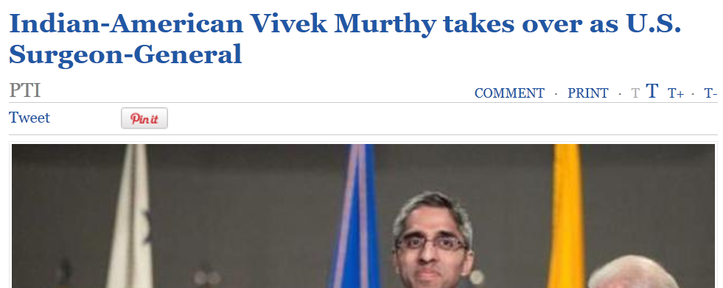
PIN: Diaspora

Slide 24
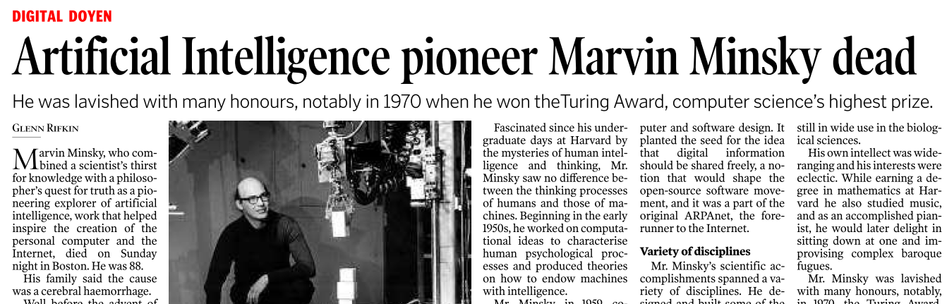
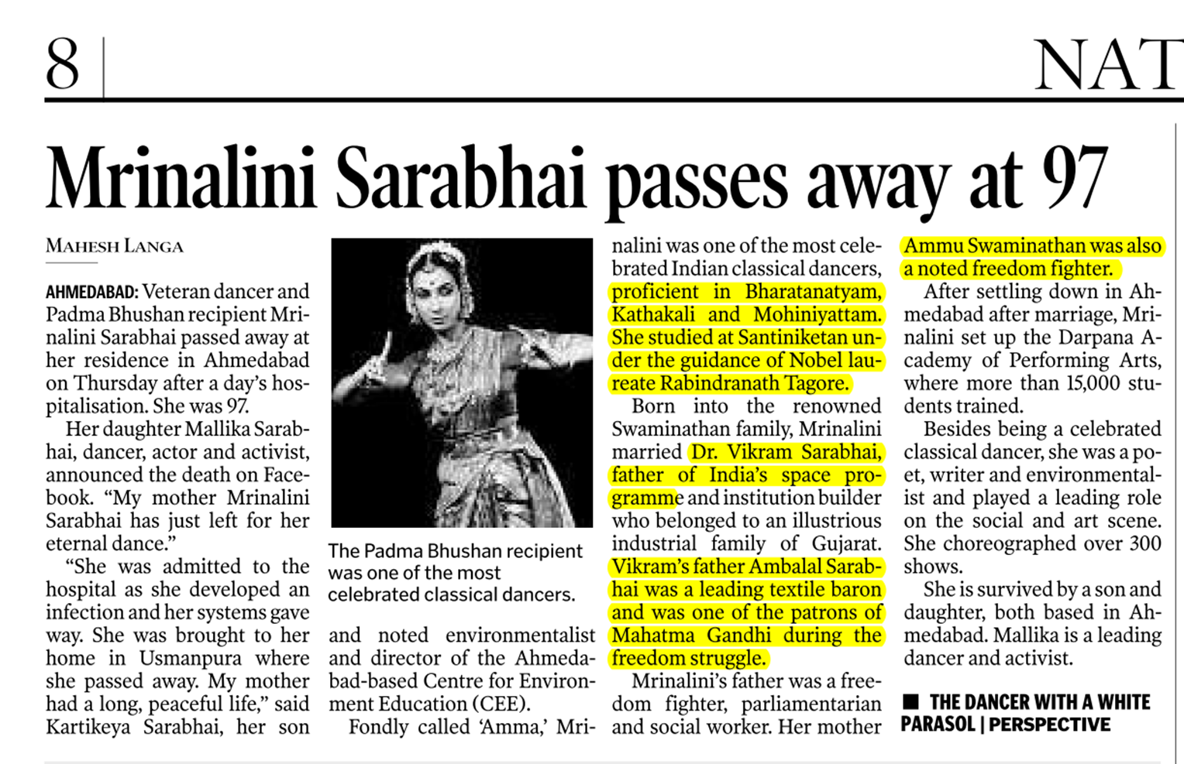
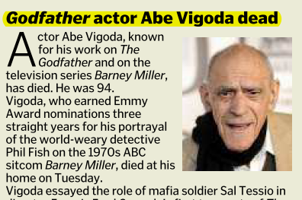
PIN: Dead

Slide 25


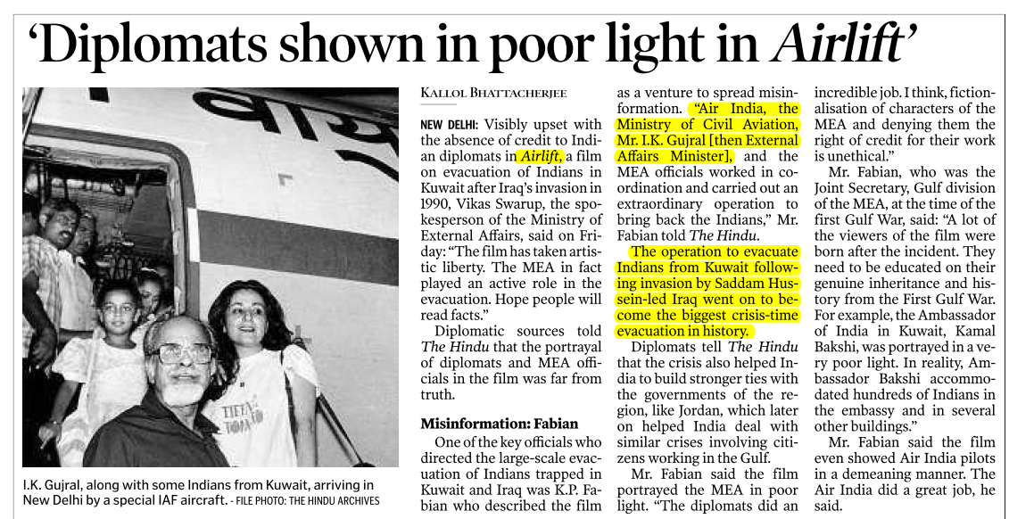
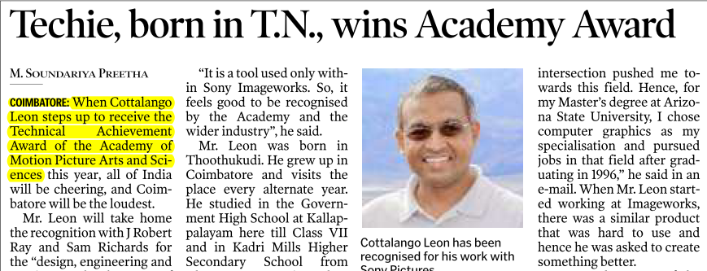
PIN- movies

Slide 26
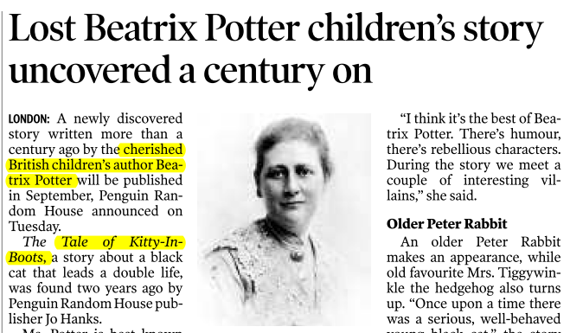
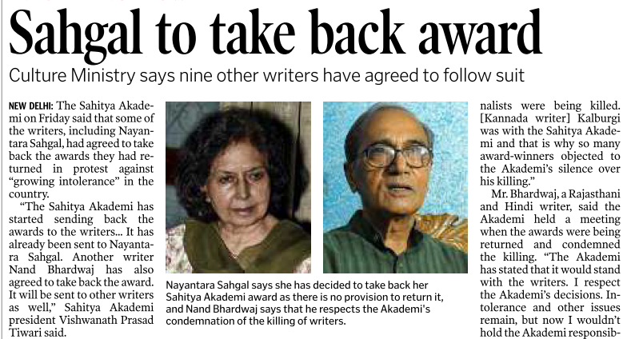


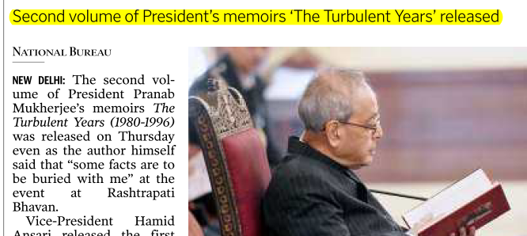
PIN: Books

Slide 27
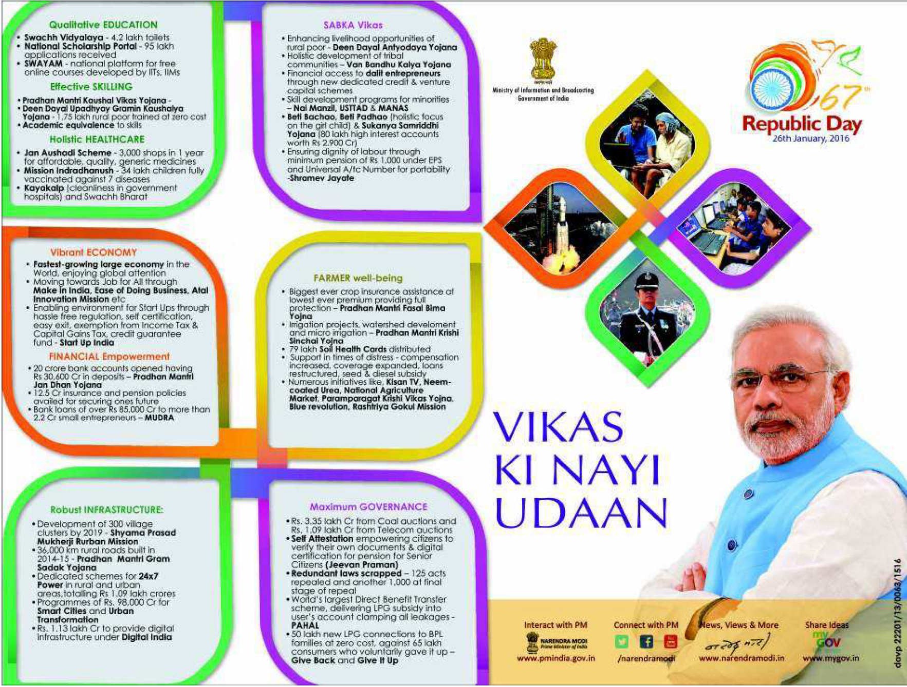
Government ads important
Notes:
Give an overview of the schemes.

Slide 28
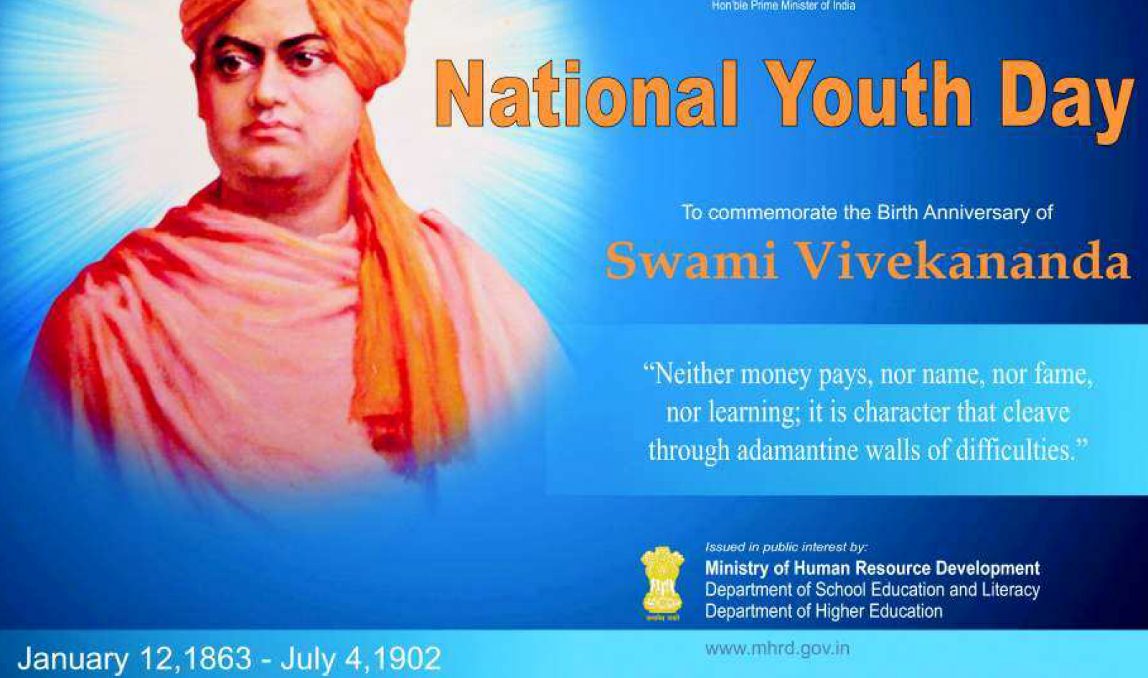
Government ads important
Quotation based Q in Essay/ GS4
115 years in 2017

Slide 29
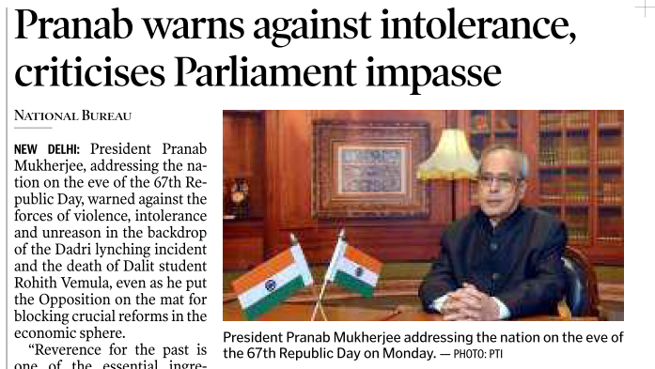
President and VP speeches also important
http://presidentofindia.nic.in/speeches.htm
For VP’s speech, google following term: “Vice President's Secretariat site:pib.nic.in”

Slide 30
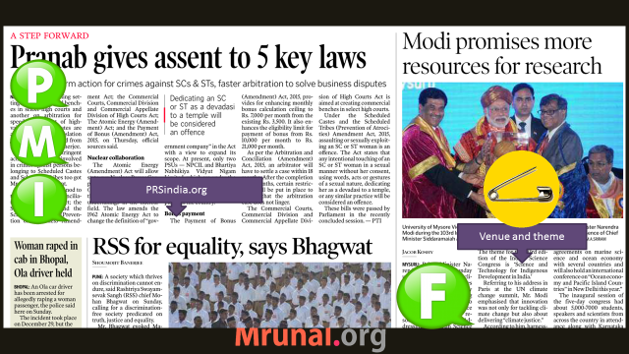
Combining all together
ISC- theme “sci-tech for indigenous Development of India”
10 Jan- VP speech on “Scientific Temper: A pre-requisite for Knowledge based Society” link
Plenty of good points, quotations.

Slide 31
What else?
Magazines
Notes making
Time management

Slide 32
Magazines
Frontline (MUST)
EPW (not must)
offline => online article download
Book review=> fodder
History, Culture
Polity, IR, environment
Socio-economic essays
book review=>fodder
Too many data sets and case studies

Slide 33
MAGAZINES
Yojana | Kurukshetra
Science reporter
Competitive magazines:
CST | wizard | chronicle (LIBRARY)
Pratiyogita Darpan (sports, PIN, Q.Papers)
If time permits: Loksabha TV debates | AIR News | DD News
Bottom-line: don’t burn your slum for topper’s palace.

Slide 34
Notes Making
Why?: Lengthy Mains-papers. Speed vs elegance.
Essay and Vague question- bol-bachchan-giri requires practice.

Slide 35

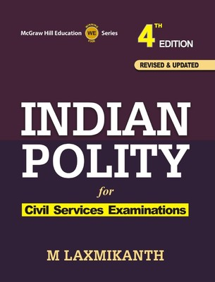
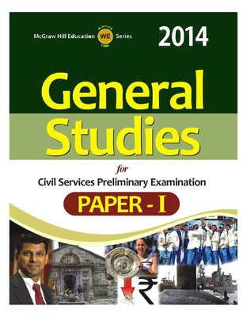
Notes not required, HIGHLIGHTER

Slide 36

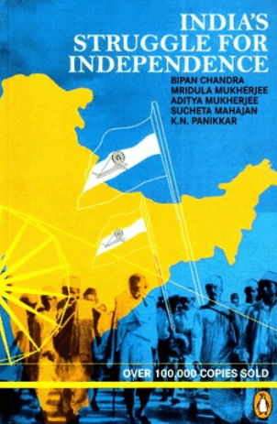

Margin Notes

Slide 37
Full length notes
Where?
How?
Optional Subject
Current Affairs
Maths: Diary of mistakes
Paper notes
Electronic notes

Slide 38


Better make notes in loose papers, because easy to update new data in it.
Bookmarks
L-folder

Slide 39

A4 papers & folders
Report files
Indexing
Continuous Writing Practice

Slide 40

Movies, torrents, games
MS Office, Notepad++, foxit PDF reader, Wordweb dictionary
Onenote (I prefer) | Evernote | Google Keep
Mindmaps: freemind, mindjet mindmanager (I prefer)
Mobile Apps: Calendar, wunderlist- track of tasks, Powerpoint
Softwares, Apps

Slide 41

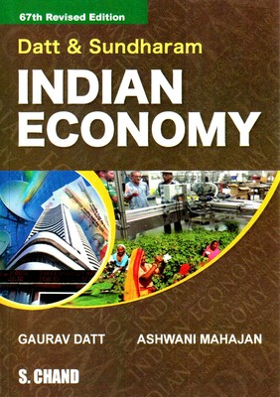
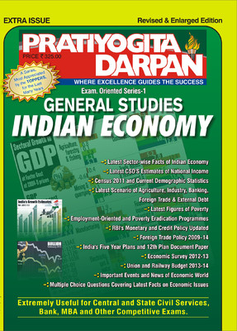
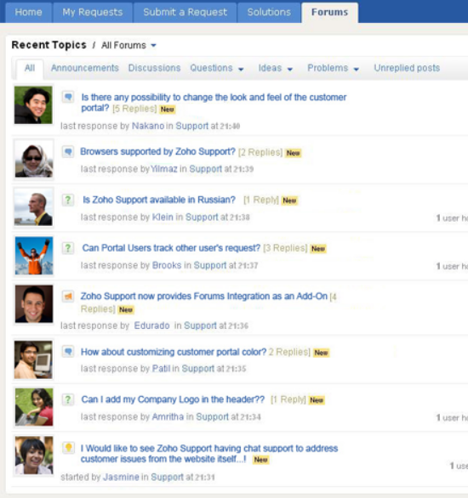
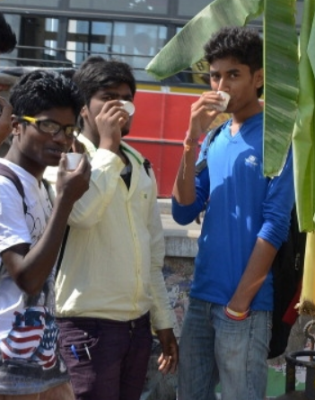
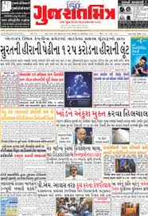
Quality study hours

Slide 42
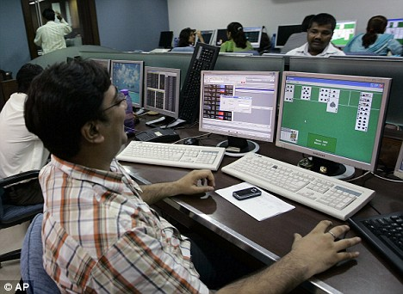


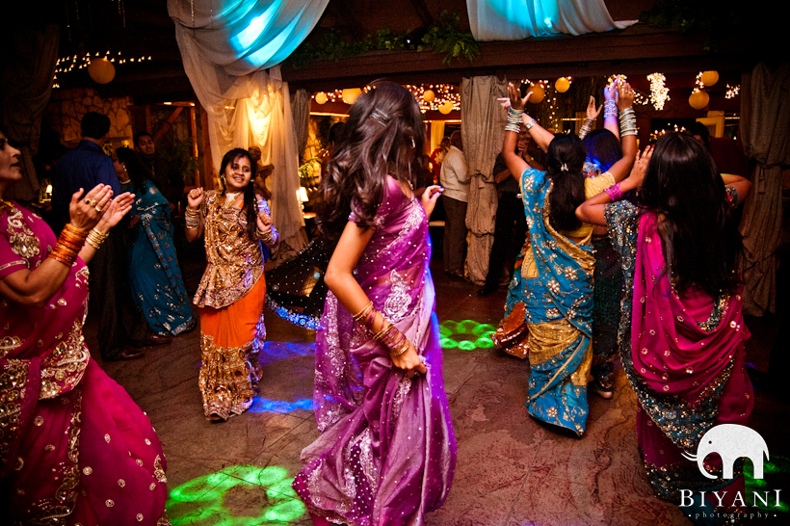

Quality study hours
Whatsapp study group
=jokes, photos
Blindly forwarding GK/links from other group
Fatigue increased more
You’ll always feel guilty because your batch mates will get “settled” sooner
Don’t waste time in social gathering

Slide 43

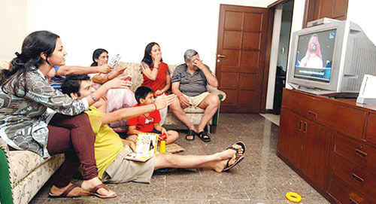
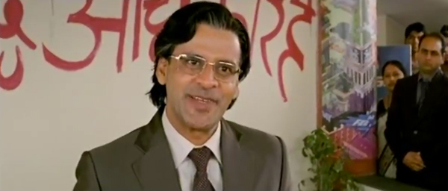
Quality study hours
Better to rent room than do up down.
1. Skip 2. Attempt 3. Mark n Review

Slide 44


After exam
Should manually solve the q.paper after exam is over.
And not through ‘googling’ but by searching books / material / notes you had

Slide 45
Advance planning required
RBI Grade “B” Officer: 60% | 50% in each year/sem. (Mains-optional subjects with technical syllabus.)
IBPS (high speed Data interpretation, reasoning)
SSC (Trigonometry, Quadratic Eq., Mass cheating)
CAPF: 25 YEARS age limit + physical norms tough
CDS: eye sight, physical norms tough
ACIO: “frame”, ~60k bond
EPFO, ESIC (Labour / HR Degree preferred)
CAT (“Profile Score”, weightage to 10,12th, Extra-C)

Slide 46

Bottom of
Mrunal.org
For vacancies
Notification (Age)
OBC vs SEBC
Non-Creamy Layer

Slide 47

First things first
CCC certificate
IGNOU form
June / July Session (2016)=> 2017 1st year exam
Only Masters OR PG diploma (UGC-NET)

Slide 48
Your Cooperation
Manpower constrains: Attendance sheets, Mock tests
Hostel vs. city; vehicle-pooling
Facebook page/group
Please don't mark anything in newspapers, magazines and books.

